Slide 1

Docker 101
Notes:
Goedeavond
Mijn naam is Johannes Sim.

Slide 2
Docker 101
Goal:
Practical 101 Docker
Tell / Show / DIY
Key take away:
What Docker is and can do for you
Doing Docker 101 with confidence
Audience: DEV collegues

Slide 3
DISCLAIMER
Our view and way of working of Docker
Docker is changing constantly
Version CE 17.06.2.-ce

Slide 4
CoNTENT Docker 101
What & Why Docker?
Examples
static website in 1 container on 1 DockerHost
Linux host / Docker UI
(our) Docker workflow
Docker commands explained
Some Topics

Slide 5
WHY Docker?
No more: works on my laptop
Time to Market
CI/CD (Continuous Integration / Continuous Delivery)
Time from commit to in production
DevOps
Try something new
Testing
…….
Notes:
DevOps
Time to Market
Time from commit to in production
Continuous Delivery
Build – Ship – Run
Works on my laptop
UseCase
Linux tool
Package manager

Slide 6
OUR DOCKER Definition FOUND on INTERNET
is the world's leading software container platform
available for developers, ops and businesses
to build, ship and run
any app
on any infrastructure.
Notes:
Waarom deze deze definitie:
World leading op dit moment
Container = Docker
Actors: dev / ops /business
ANY app (microservice / monolit / enz)
Infra (laptop / server on premise / cloud

Slide 7
Some User storIES
As Product Owner I want features and an easy process to change and maintenance process
As DEV I want to build application only once and be sure that it is the same software
As OPS I want the same software in each environment
As Bus I want a short time to market for application feature

Slide 8
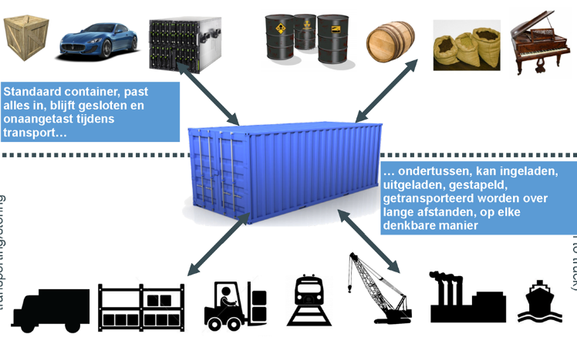
WORKS in MY MACHINE APP in A Container

Slide 9
WORKS ON MY MACHINE RUN – CONTAINER
Applicatie
Applicatie
JAVA 7
JAVA 7
BINS/LIBS
BINS/LIBS
Docker
Docker
Operating System (Kernel)
Operating System (Kernel)
Infra
Infra

Slide 10
WORKS ON MacHINE RUN - ISOLATION
Applicatie
Applicatie
JAVA 7
JAVA 7
BINS/LIBS
BINS/LIBS
Docker
Operating System (Kernel)
Infra

Slide 11
WORKS on MY MACHINE BUILD IMAGE
Applicatie
JAVA 7
BINS/LIBS

Slide 12
WORKS ON MY MACHINE SHARE – HUB - STORE

Slide 13
Build – SHIP - RUN
Build
Ship
Run
DEV
OPS
Dockerfile
Image
Container
Docker Registry
Docker hub/store

Slide 14
TIME TO MARKET
idee
Make image
Docker
registry
Deploy
container

Slide 15
CI/CD
Config
Make image
Docker
registry
Deploy
container

Slide 16
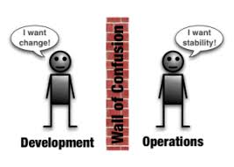
DEVOPS
Laptop
Maintenance
PROD
Acceptatance
Config
Config
Laptop
Test
Docker
registry
images
Docker
registry
Laptop
Dev
Notes:
One team – one repro
Different suppliers

Slide 17
Docker “Concepts”
Container “standard”
Build once – run anywhere
Container
in “production”
Everything what is needed and nothing more
1 process – 1 task
Immutable
Build – Ship - Run

Slide 18
IMPORTANT to KNOW?
DockerFile
Blueprint / receipe
Image
Layers
Registry – Docker Hub – Docker store
“store”
Container
Runnning image
Notes:
Container == running image
Image = class
Container = instance
One image, many containers
Containers are immutable

Slide 19

DOCKER ARCHITECTURE HigH LEVEL
https://docs.docker.com/engine/docker-overview/
Notes:
High Level overview
Docker CLI
Docker API
Docker Deamon
https://docs.docker.com/engine/docker-overview/

Slide 20
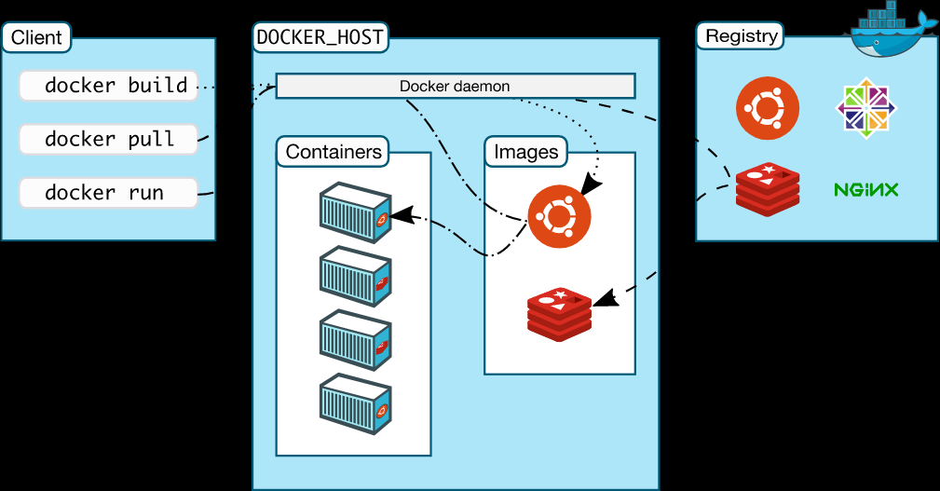
DOCKER ARCHITECTURE HigH LEVEL
https://docs.docker.com/engine/docker-overview/
Notes:
High Level overview
Docker CLI
Docker API
Docker Deamon
https://docs.docker.com/engine/docker-overview/

Slide 21
TOPIC: VM versus Container
Docker containers are not VM’s
Analogy
Apartment building = VM
Appartment = Docker Conatiner
Share of kernel
Real world
DockerHost are VM’s
Docker can also run directly on server with OS
Notes:
Zie
DeepdiveDocker
Apartementgebouw
Container are not VM
Use Case
Docker on VM (DC, Azure)

Slide 22
Topic: DOCKER versionS
Notes:
Docker 1.13 = Docker 17.03
CE is production ready
2 release channels
Edge each month
Stable each 3 month
Diagram
predictable

Slide 23
Example: OUR Container WORKFLOW
Case: Static website
HTML pagina on webserver nginx
Code: HTML
Dockerfile
Build an image
Run container
Show result
Push to registry
Pull from registry
Run Azure DockerHost
Notes:
Starten van

Slide 24
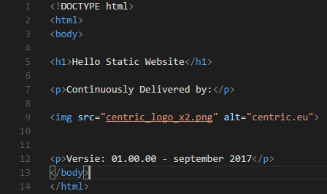
Example: HTML

Slide 25
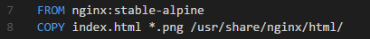
Example DockerFILE

Slide 26
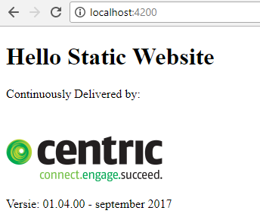
Example DOCKER RUN
docker container run --name staticws -d -p 4200:80 centricms/staticws:latest
df16bf953be84b16fe3f8b67cd90d50a056b17b5a8a3fc4075a92634c3720b65

Slide 27
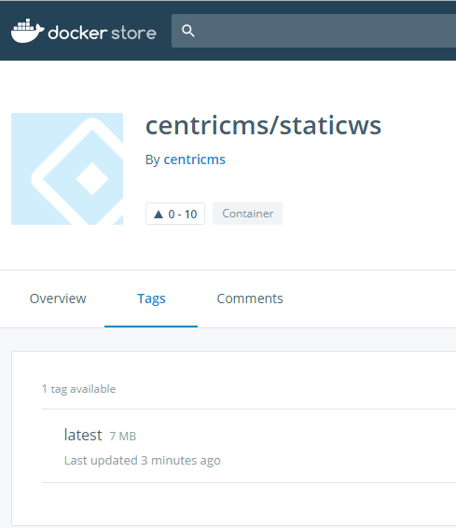
EXAMPLE PUSH
docker push centricms/staticws
The push refers to a repository [docker.io/centricms/staticws]
645034a2dbe2: Pushed
1690bc77acd5: Mounted from library/nginx
cbeb94c1f91a: Mounted from library/nginx
4bbeb364e643: Pushed
040fd7841192: Pushed
latest: digest: sha256:3b473ed6b592d06ea0f191972cf49ad13c62912733d8e0a7bb5c2a5319dbe5dd size: 1362

Slide 28
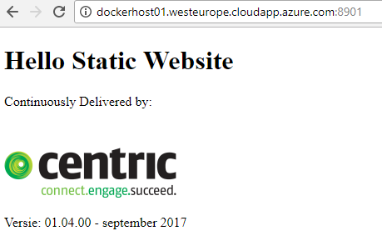
Example PULL FROM AZURE HOST
docker pull centricms/staticws:latest
latest: Pulling from centricms/staticws
ab14e39f58e6: Pull complete
206c8e58fb89: Pull complete
aeb57280dce6: Pull complete
9a661d863527: Pull complete
0459f9b530b7: Pull complete
Digest: sha256:3b473ed6b592d06ea0f191972cf49ad13c62912733d8e0a7bb5c2a5319dbe5dd
Status: Downloaded newer image for centricms/staticws:latest
docker container run --name staticws -d -p 8901:80 centricms/staticws:latest
Notes:
dockerhost01.westeurope.cloudapp.azure.com
Centric/Centric2017!
docker pull centricms/staticws:latest
docker container run --name staticws -d -p 8901:80 centricms/staticws:latest
http://dockerhost01.westeurope.cloudapp.azure.com:8901/

Slide 29
OUR WAY of WORKING
On laptop
GIT
VS CODE
DockerForWindows
Internet
GitHub
Docker Hub / Docker Store
Cloud
DockerHost on Azure

Slide 30
LAPTOP, internet, CLOUD

Slide 31
WORKFLOW
Docker
registry
Push
image
Pull
Container
Perform
Change
Make
image
Deploy
container

Slide 32
Needed on Laptop
GIT
VS CODE
DockerForWindows
Windows 10 with Hyper-V
Browser (Chrome)

Slide 33
InstaLL
GIT
https://git-scm.com/download/win
VS CODE
https://code.visualstudio.com/docs/?dv=win32
Download GitHub repro
New directory
Clone repro
https://github.com/RenzoVeldkamp/MicroContainer
in directory
Git clone https://github.com/RenzoVeldkamp/MicroContainer.git

Slide 34
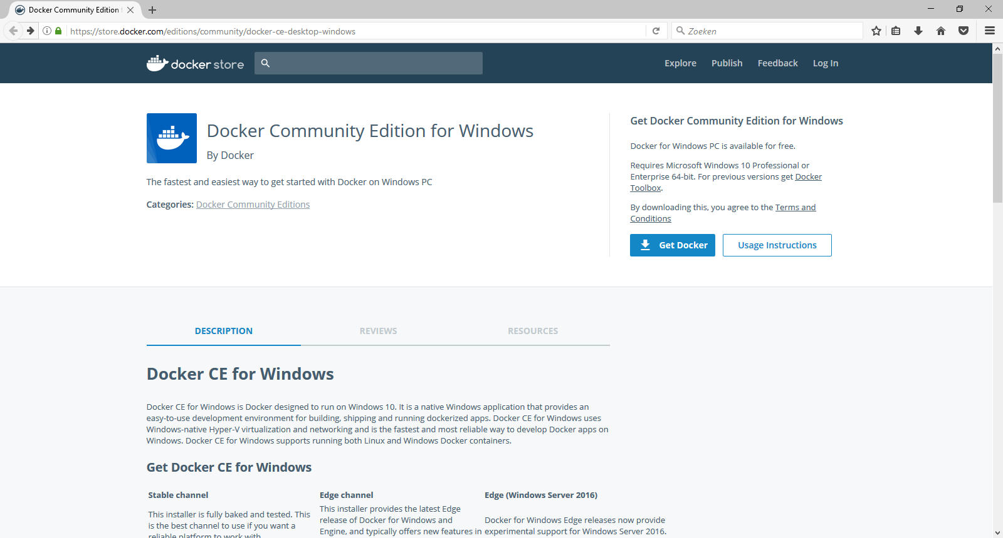
Docker downloaden
https://store.docker.com/editions/community/docker-ce-desktop-windows

Slide 35
Command LINE INTERFACE
How:
Powershell window in VS Code
Powershell
CMD
Docker <command>
Docker management commands
docker container <command>
docker image <command>
Docker –-help
https://docs.docker.com/engine/reference
Google search

Slide 36
Docker Command LINE INTERFACE
Build
Ship
Run
Docker image ls
Docker container run
Docker pull
Docker container ls
Docker image rm
Docker push
Docker container rm
Docker build
Docker container exec
Docker container start
Docker container stop
Docker system info
Docker system prune
Docker version
Notes:
docker system info
docker info
docker info
Command Line Interface

Slide 37
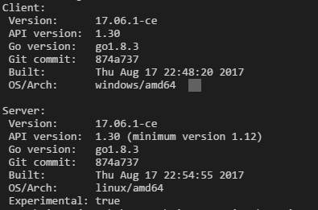
WHICH VERSION
Docker version
Docker-compose version
Docker-machine version
Docker info
Lot of info

Slide 38
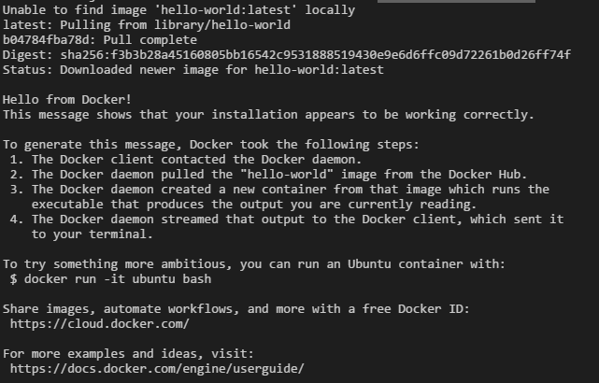
Check Docker: PULL AND RUN
docker container run hello-world

Slide 39
EXPLAIN docker container RUN
docker container run hello-world
Run container with the content of image called hello-world
hello-world cannot be found on the DockerHost (Laptop)
hello-world will be pulled from the Docker Hub / Store
Hello-world will executed and end
docker docker run hello-world (once again)
Image on the Docker Host

Slide 40
WhiCH cONTAINERS ARE Runnning?
docker container ls
Will only show the running containers
Old command: docker ps
backwards compatible
docker container ls –a

Slide 41
EXAMPLE – EASE of Docker Ready to RUN - containers
Docker registry
Docker Hub
https://hub.docker.com/
Docker Store
Notes:
Hub - community
Store – private and paid official
Private on premise
Private
Official en unofficial
User-id / repro
Tags
Inloggen

Slide 42
EXAMPLE – EASE of Docker Ready to RUN - container
Run a Linux machine on my laptop - Alpine
Run a Docker UI - Portainer
We show:
Docker store (docker hub)
Pull image
Run container
Show result
Ship
Run
Image
Container
Notes:
https://store.docker.com/images/alpine

Slide 43
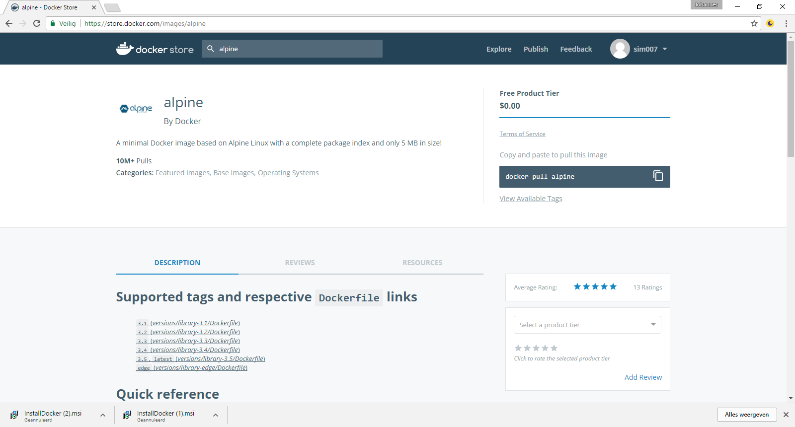
Alpine REPRO

Slide 44
LINUX ALPINE
Nr | Step | Commando
1 | Go to Docker store | https://store.docker.com/images/alpine
2 | Copy docker command | copy
3 | Go to Docker | docker pull alpine
4 | Run the container | docker container run –it alpine /bin/sh

Slide 45
GIVE some COMMANDS Alpine
 | Command
Linux version | cat /etc/*-release
 | Pwd
Show directory | ls
User | Whoami
Close Alpine container | Ctrl-D
Check if container is still running:
Docker container ls
Docker container ls -a
Notes:
docker pull alpine
docker run -it alpine /bin/sh
Alpine
cat /etc/*-release
Pwd
Ls
Whoami
exit
docker ps

Slide 46
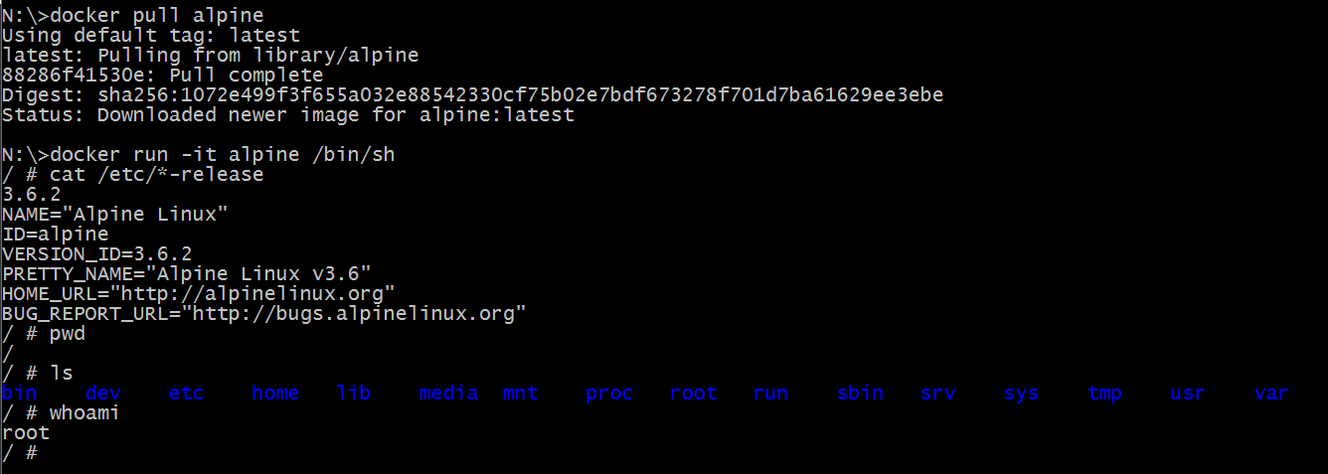
ALPINE result
Notes:
docker pull alpine
docker run -it alpine /bin/sh
Alpine
cat /etc/*-release
Pwd
Ls
Whoami
exit
docker ps

Slide 47
EXAmPLE – ease of DOCKER PORTAINER
Command:
docker container run -d -p 9000:9000 -v /var/run/docker.sock:/var/run/docker.sock portainer/portainer
Docker Store:
https://store.docker.com/community/images/portainer/portainer
Website:
https://portainer.io/
Documentation

Slide 48
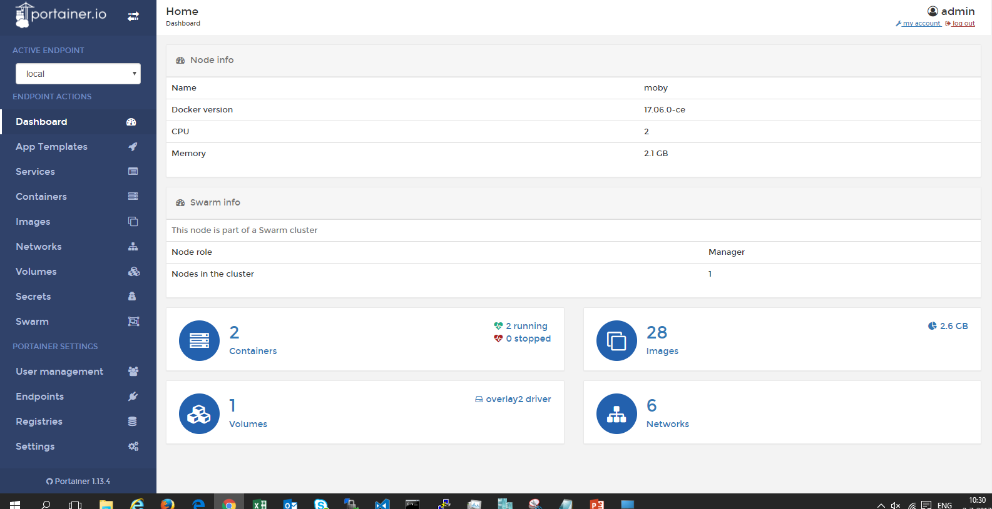
EXAMPLE – EASE of Docker PoRTainer
docker run -d -p 9000:9000 -v /var/run/docker.sock:/var/run/docker.sock portainer/portainer

Slide 49
ExPLain Configuration on runtime
docker container run -d -p 9000:9000 -v /var/run/docker.sock:/var/run/docker.sock portainer/portainer
 | Explain
docker container run | depricated command: docker run
-d | detached – run on background in the cli
-p <hostport> <container port> | publish
-v | use volume
Read more | https://docs.docker.com/engine/reference/commandline/container_run/

Slide 50
DOCKER Commands
Build
Ship
Run
Docker image ls
Docker container run
Docker pull
Docker container ls
Docker image rm
Docker push
Docker container rm
Docker build
Docker container exec
Docker container start
Docker container stop
Docker system info
Docker system prune
Docker version
Notes:
docker system info
docker info
docker info
Command Line Interface

Slide 51
STATICWS
docker container run --name staticws -d -p 4200:80 centricms/staticws:latest
df16bf953be84b16fe3f8b67cd90d50a056b17b5a8a3fc4075a92634c3720b65

Slide 52
EXPLAIN DOCKER CONTAINER RUN
docker container run --name staticws -d -p 4200:80 centricms/staticws:latest
 | Explain
docker container run | Old command: docker run
--name | Container name Name must be unique!
-d | detached – run on background in the cli
-p <hostport> <container port> | publish 4200:80
<name image> | <user>/<name>:<tag>
Read more | https://docs.docker.com/engine/reference/commandline/container_run/

Slide 53
Multiple containers from 1 image
Try:
docker container run --name staticws –d –p 8000:80 centricms/staticws:latest
docker container run --name staticws –d –p 8000:80 centricms/staticws:latest
→ error same name
docker container run -d -p 8000:80 centricms/staticws:latest
docker container run -d -p 8000:80 centricms/staticws:latest
→ error same hostport
docker container run -d -p 8001:80 centricms/staticws:latest
docker container run -d -p 8002:80 centricms/staticws:latest
→ 3 static website

Slide 54
EXPlain PuBLISH
Container
Container
Container

Slide 55
Explain DOCKER LS
 | Explain
Container ID | Unique nuber
Image | 3 Containers from the same image
Start command | detached – run on background in the cli
Created
Status
Ports | Host port → container port / portocol
Names | No –name, Docker provide unique name
Read more

Slide 56
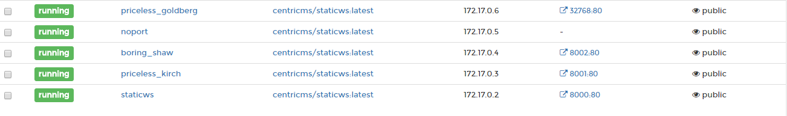
EXPLAIN - P, Docker will assign port

Slide 57
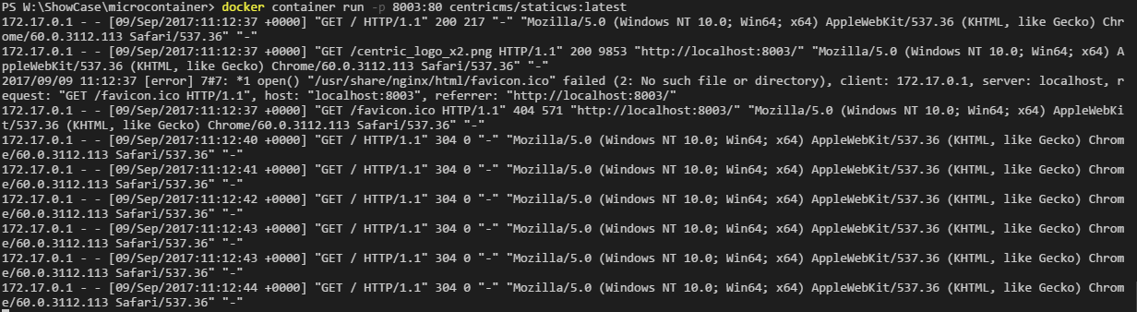
EXPLAIN -d -detached

Slide 58
DOCKER CONTAiNERS COMMAND
Docker container run
new container from image
docker container run –rm – run, after stop remove
Docker container stop
Docker container start – container must exist
id or container- name

Slide 59
DOCKER EXEC
docker container exec -it <containername> /bin/sh
Look in the container
Depends on base image

Slide 60
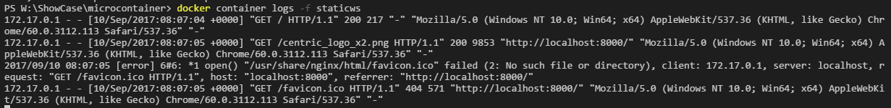
DOCKER LOGS
docker container logs –f

Slide 61
Remove DOCKER CONTAINER
Running & Stop containers
Remove container
Docker container rm <container>
Remove running container
Docker container rm –f <container>
Remove all stopped contaners
Docker container prune

Slide 62
DEMO: RuN on AZURE

Slide 63
Docker Command
Build
Ship
Run
Docker image ls
Docker container run
Docker pull
Docker container ls
Docker image rm
Docker push
Docker container rm
Docker build
Docker container exec
Docker container start
Docker container stop
Docker system info
Docker system prune
Docker version
Notes:
docker system info
docker info
docker info
Command Line Interface

Slide 64
Docker REGISTRY
Ready to use:
DOCKER HUB / DOCKER STORE
Private registry
For companies & enterprises

Slide 65
DOCKER PUSH
You need a user-id on Docker Hub
Free of charge for public repro (images)
Docker login
Every repro (image) name must start with your user
Version – tag
Example
docker push centricms/staticws:latest

Slide 66
DOCKER IMAGE PULL
For Docker Hub / Store
No user-id needed
Official & open source
Official by Docker or supplier
Tips:
Use safe images: official, number of pull, rating, now the owner
Intelligent download (only chages)
Image is first search on local DockerHost

Slide 67
Docker Command
Build
Ship
Run
Docker image ls
Docker container run
Docker pull
Docker container ls
Docker image rm
Docker push
Docker container rm
Docker image build
Docker container exec
Docker container start
Docker container stop
Docker system info
Docker system prune
Docker version
Notes:
docker system info
docker info
docker info
Command Line Interface

Slide 68
DOCKERFILE
Recipe or blue print
Each line will be layer
Each layer will be cached

Slide 69
WHAT is IMAGE?
Image = stack of layers
Made by:
Dockerfile = receipe or blue print
Docker commit – seldom use – not in this Docker 101
Container made from mage must run on any environment

Slide 70
EXAMPLE DOCKER BUILD - DOCKERIZE
DOCKERIZE = PACKAGE application in a Docker image
Image / container
consist every dependency
Small
Secure
….
Best practice:
Use the same image for very environement

Slide 71
TOPIC: DOCKER BUILD DockerFILE
Dockerfile: Recipe or blue print
Base image
FROM SCRATCH
KNOWN TRUSTED IMAGE (OFFICIAL)

Slide 72
TopIC: Version
TAG
Latest
default is nothing is specified
use with care
No tag: build - snapshot
Base OS
Alpine – Docker default - small
Debian
Windows

Slide 73
DoCKERFILE FOR StaticWS
Goal & requirement:
Static website that can run on laptop and Azure
Easy webserver – use nginx
Fit in the our way of working (CD flow)
Build a Docker image
Image = stack of layers
Dockerfile = receipe or blue print

Slide 74
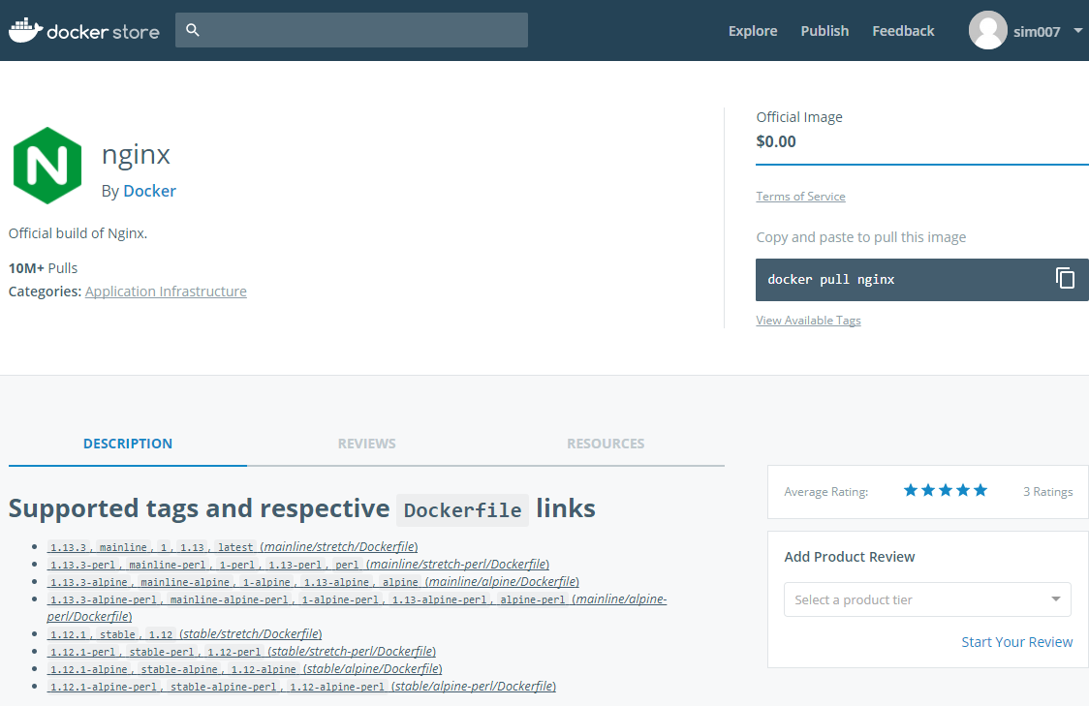
Search for NgINX

Slide 75
DOCKER BUILD
Make Dockerfile
Base on base image
From docker Store
From scratch
Copy static files to correct directory
Build the image with:
Docker image build –t <name> .
Tips
Dockerfile
CLI must be in the same directory as Dockerfile
Do not use netdrive or on W10

Slide 76
ExPLain DOCKER BUILD
Docker image build –t <name> .
 | Explain
docker image build | depricated command: docker build
-t <name> | Tag a unique name
. | directory
Read more | https://docs.docker.com/engine/reference/commandline/image_build/

Slide 77
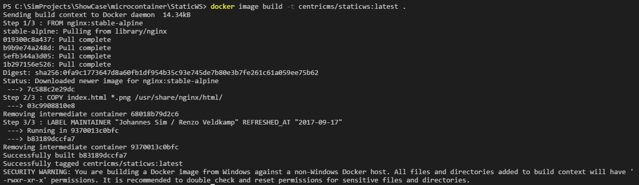
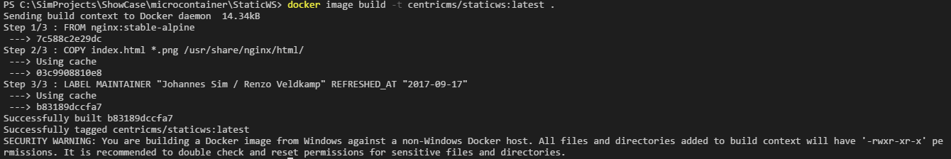
Example OUTPUT (first TIME and repeat)

Slide 78
Command DOCKER IMAGE
Docker image --help | List options for docker image
Docker image ls | List docker images | Listed deprecated: Docker images Image has id and repo name
Docker history <image> | Give Dockerfile commands
Docker inspect <image> | Lot information

Slide 79
Docker Command LINE INTERFACE
Build
Ship
Run
Docker image ls
Docker container run
Docker pull
Docker container ls
Docker image rm
Docker push
Docker container rm
Docker build
Docker container exec
Docker container start
Docker container stop
Docker system info
Docker system prune
Docker system version
Notes:
docker system info
docker info
docker info
Command Line Interface

Slide 80
Command DOCKER IMAGE
Docker system prune | Delete all not running containers and used images
Docker system prune -a | Delete all containers and images | Clean docker environment
df | Show docker disk usage
events | Get real time events from the server
info | Display system-wide information

Slide 81
SummaRIZE our WorkFLOW
What is on the laptop?
Static website
Build
Build the image
Ship –Flow
Push to Docker Hub / Docker Store
Pull from Docker Hub / Docker Store
Run
Run on Laptop
Run on Azure host

Slide 82
LAB IMMUTable container
Start an alpine container
Add a file Centric in home directory
echo “deze file heet centric” >> centric
Stop the container with exit
Case 1: start new container
docker container –it alpine sh
Result: no file Centric
Case 2: start old container
docker container ls –a (find the container-id)
docker container start <id>
docker exec -it <id>
Result: Centric file

Slide 83
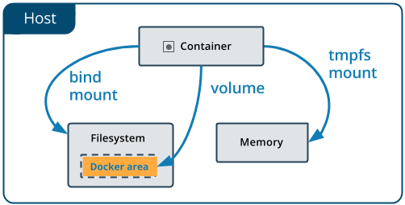
LAB DOCKER VOLUME
DEV flow – dev mode
Changes in code change without building

Slide 84
Old

Slide 85
Course overview
Day 1
Day 2
Microservices
Docker
Microservices
Docker
1
Introduction
Recap day1 & queries
2
MS 101
MS 102
3
Docker 101
Docker 102
4
Workshop NodeJS example
Workshop .Net example
5
Wrap-up & queries
Wrap-up

Slide 86
On YOUR Laptop

Slide 87
Docker DeMO
Docker installeren
Docker CLI interface
“hello world”
.net site
Webserver + test
Jenkins
Benchmark security test
Docker UI / Kitematic

Slide 88

Samenvattend: DOCKER MODEL
DEV “bepaalt” de stack
Dezelfde Container (running image) op iedere omgeving
1 Registry voor images
image = interface (tussen DEV en OPS)
API (Application Program Interface)

Slide 89
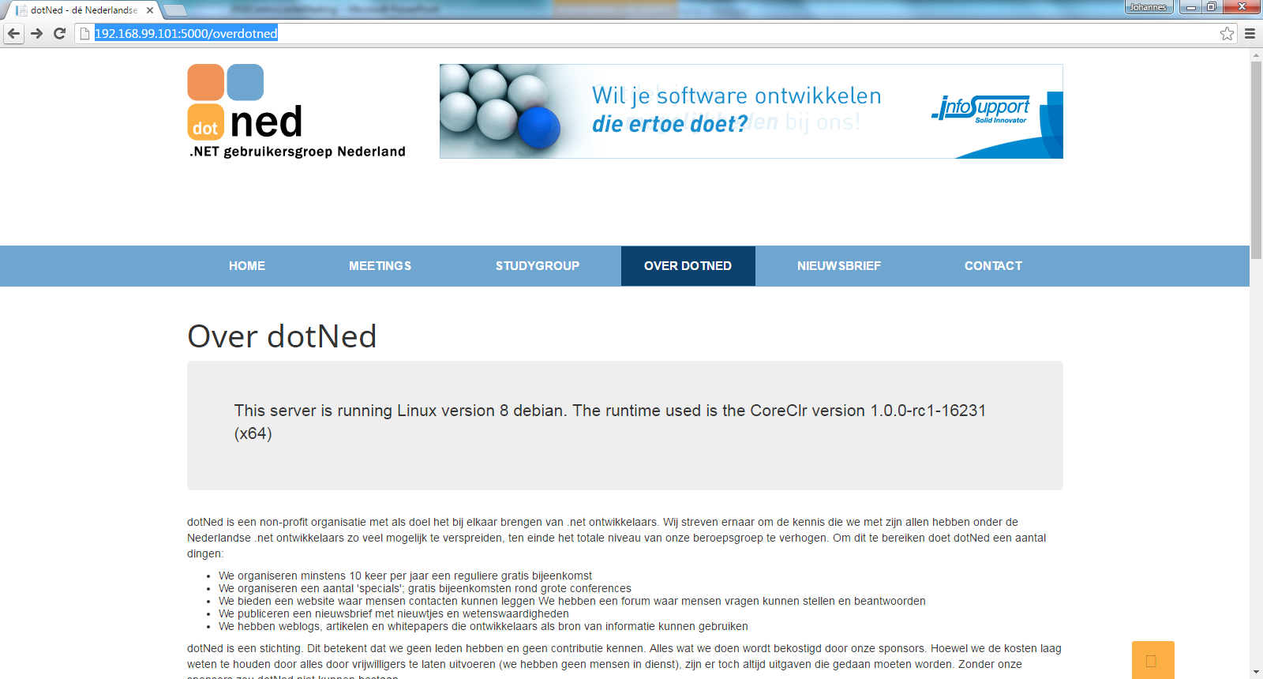
Voorbeeld: .net site in Docker container

Slide 90
CD PIPeLINE
Notes:
It depens uiteraard op de context.
Wat missen jullie?
OTAP
Quality gates

Slide 91
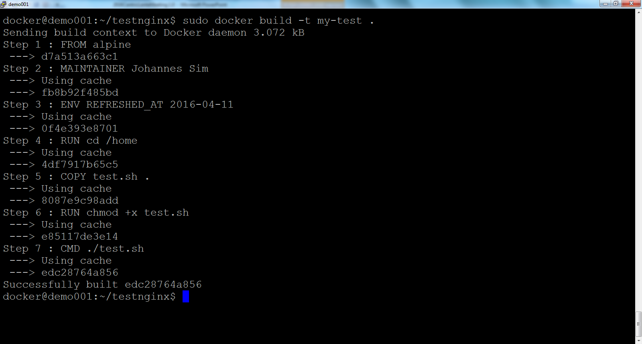
VOORBEELD: build test container

Slide 92
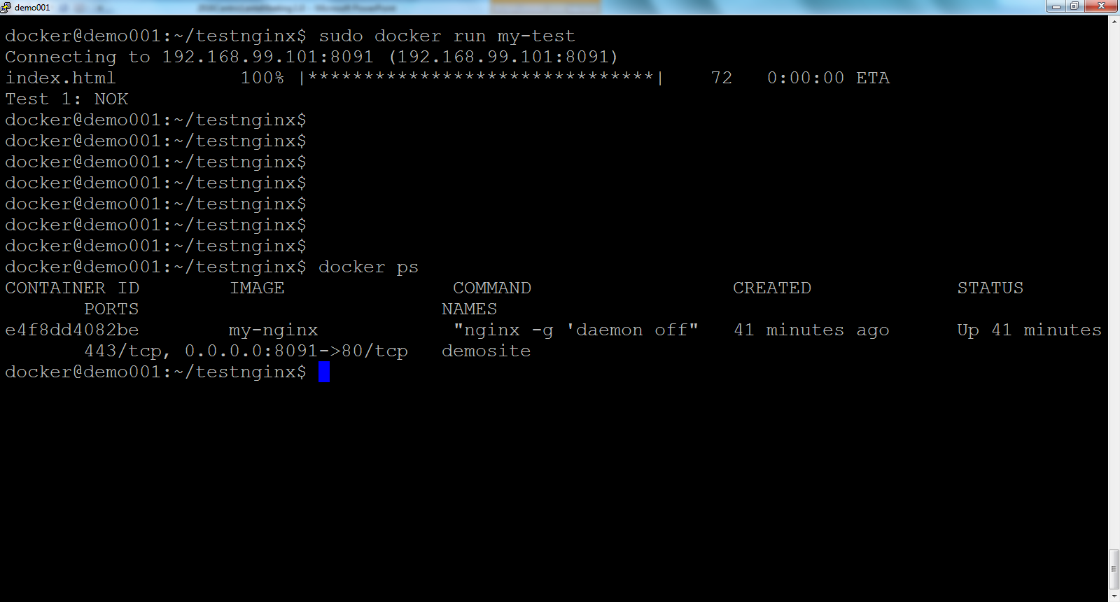
VOORBEELD: RUN TeSTCONTAINER

Slide 93
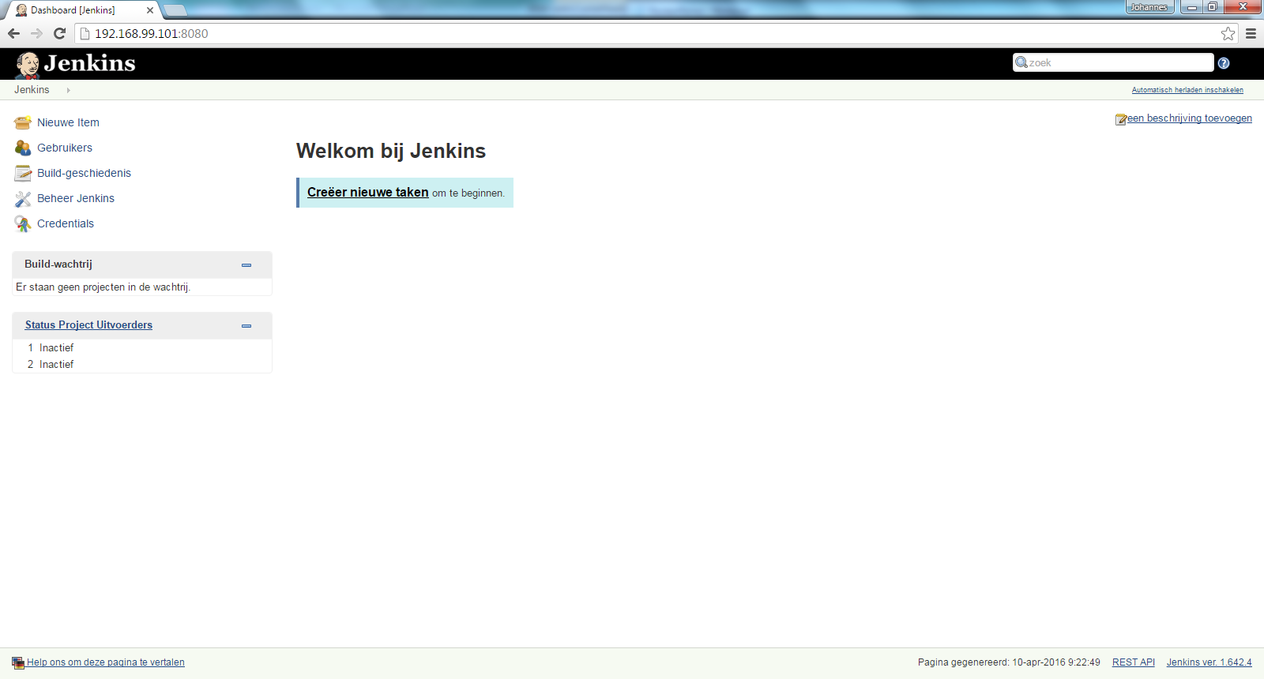
Voorbeeld: Jenkins in Docker container

Slide 94
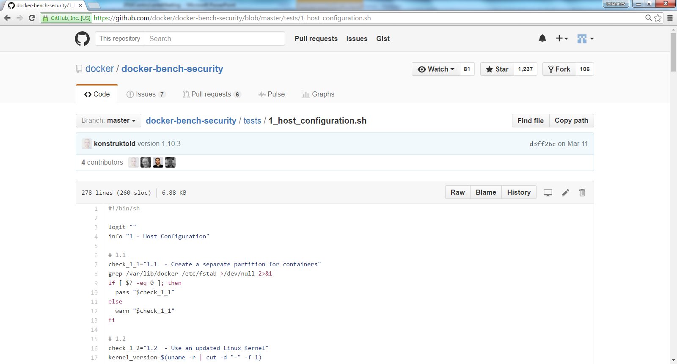
VOORBEELD: Testscript in GIT

Slide 95
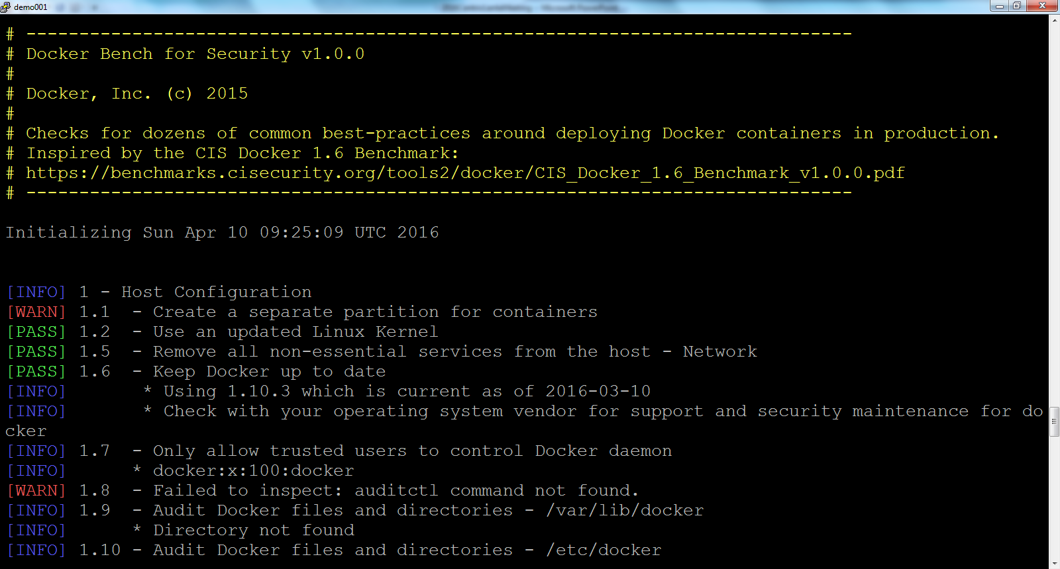
Voorbeeld: Test in Docker container

